Slide 1
Information Security
Course Code: CSC432
Credit Hours: 3(3, 0)
Lecture: 3-4
Dr. Tehsin Kanwal
Assistant Professor

Slide 2
Information Security
This course introduces the concepts and applications of information security. Topics include:
Information Security Overview;
Threats & Attacks; Legal & Professional Issues;
Authentication Models;
Access Control
Attack prevention tools and techniques
Auditing, testing, and monitoring
Information Security Management & Risk Management
Information Security Standards, Certifications, and laws
Text and Reference Books Text Book:
Principles of Information Security, 6th edition by M. Whitman and H. Mattord
Computer Security: Principles and Practice, 3rd edition by William Stallings.
Introduction to Computer Security, Goodrich, M., & Tamassia, R., Pearson, 2021
Information Security Policies, Procedures, and Standards by Douglas J. Landoll , O’Reilly , ISBN: 9781315355474
CISSP Official Study Guide 7 Edition, by James Michael Stewart, Mike Chapple, and Darril Gibson. PDF available on Moodle. Wiley, ISBN: 978-1-119-04271-6
Computer Security, 3rd edition by Dieter Gollmann
Computer Security Fundamentals, 3rd edition by William Easttom

Slide 3
What is Information Security
Information security, is a set of tools and practices that you can use to protect your digital and analog information.
InfoSec covers a range of IT domains, including infrastructure and network security, auditing, and testing.
It uses tools like authentication and permissions to restrict unauthorized users from accessing private information. These measures help you prevent harms related to information theft, modification, or loss.

Slide 4
Types of Information Security
The main objectives of InfoSec are typically related to ensuring confidentiality, integrity, and availability of company information. it involves the implementation of various types of security.
Application security.
Application Security, is a security program that directly deals with applications themselves.
Its goal is to identify, rectify, and correct security issues in applications within organization.
It is totally based upon identifying and fixing vulnerabilities that correspond to weakness. Its testing also reveals weakness at application level that help to prevent attacks.

Slide 5
Types of Information Security
Data Security
Data security means protecting digital data, such as those in a database, from destructive forces and from the unwanted actions of unauthorized users, such as a cyberattack or a data breach.
How data will be secured?
Use firewalls.
Use encrypted systems.
Use VPN.
Never give authorization to external parties.
Use strong passwords and change them often.
Public networks should be avoided as much as we can like WiFi on metros, airports.
Do make trust issues while logging in another devices.

Slide 6
Types of Information Security
Infrastructure security.
Infrastructure Security deals with the threats, risks, and challenges that are associated with the security of the organization’s IT infrastructure such as the host, network, and application levels.
Common security threats to IT infrastructure
Cyber threats to technology infrastructure range from phishing attempts and ransomware attacks to distributed denial of service (DDoS) exploits and Internet of Things (IoT) botnets.
Physical dangers include natural disasters such as fires and floods, civil unrest, utility outages, and theft or vandalism of hardware assets. Any of these have the potential to cause business disruption, damage an organization’s public reputation, and have significant financial consequences.

Slide 7
Infrastructure security
What are the different levels of infrastructure security?
Data Security
As more data is generated and stored in more locations (core data centers, colocations, multiple clouds, and edges), protecting this data becomes more complex. The increasing number of devices connect to enterprise networks due to bring-your-own-device (BYOD) policies, IoT adoption, and more, meaning that a growing number of endpoints, or entry points into enterprise networks, must be protected.
Some common enterprise endpoint security measures include URL filtering, anti-virus tools, sandboxing, secure email gateways, and endpoint detection and response (EDR) tools.
Data encryption technologies also help protect data by encoding it so that only users with the correct decryption key may access it.

Slide 8
Infrastructure security
Application
Outdated software can contain vulnerabilities that cyber attackers can exploit to gain access to IT systems. Ensuring software and firmware updates are distributed and applied across the enterprise network, known as patching, helps close security holes as well as provide new functionality, performance improvements, and bug fixes for enterprise applications.
Network
A firewall typically provides the first line of defense in network security. It serves as a barrier between an enterprise’s trusted network and other untrusted networks, such as public Wi-Fi. By monitoring incoming and outgoing network traffic based on a set of rules, it only allows network traffic that has been defined in the security policy to access resources on the trusted network. Multi-factor authentication (MFA) also protects the enterprise network by requiring two or more forms of verification before allowing access to network resources.
Physical
The most robust cyber protection cannot protect your technology assets from physical theft, vandalism, or natural disasters. Data recovery plans that incorporate offsite backups located in different geographies are also a part of a physical security strategy.

Slide 9
Types of Information Security
Mobile Security
Mobile devices are now an essential need for every person for day-to-day tasks. As a result, the number of mobile users is rising exponentially. This gives us the direction to think about the data they process and what security mechanisms are being taken by mobile application developers to keep the user’s data secure.
There was a time when the biggest threat to the data was due to spyware which runs silently on the computer background and steals user data.
Now even mobile devices are a fruit target for cyber-criminals to steal your data without even getting noticed. When it comes to securing mobile data, use an antivirus application that tends to protect your data from getting breached.

Slide 10
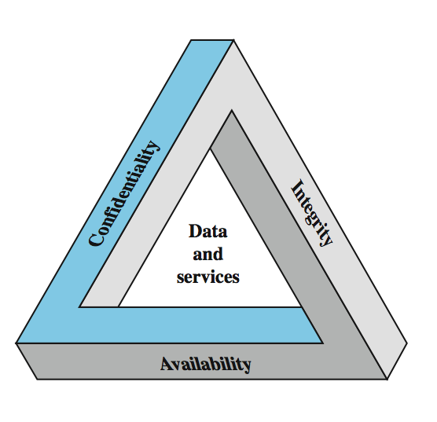
Key Information Security Concepts
Notes:
These three concepts form what is often referred to as the CIA triad (Figure 1.1). The three concepts embody the fundamental security objectives for both data and for information and computing services. FIPS PUB 199 provides a useful characterization of these three objectives in terms of requirements and the definition of a loss of security in each category:
• Confidentiality: Preserving authorized restrictions on information access and disclosure, including means for protecting personal privacy and proprietary information. A loss of confidentiality is the unauthorized disclosure of information.
• Integrity: Guarding against improper information modification or destruction, and includes ensuring information non-repudiation and authenticity. A loss of integrity is the unauthorized modification or destruction of information.
• Availability: Ensuring timely and reliable access to and use of information. A loss of availability is the disruption of access to or use of information or an information system.
Although the use of the CIA triad to define security objectives is well established, some in the security field feel that additional concepts are needed to present a complete picture. Two of the most commonly mentioned are:
• Authenticity: The property of being genuine and being able to be verified and trusted; confidence in the validity of a transmission, a message, or message originator. • Accountability: The security goal that generates the requirement for actions of an entity to be traced uniquely to that entity.

Slide 11
Three key objectives (the CIA triad)
Confidentiality
Data confidentiality: Assures that confidential information is not disclosed to unauthorized individuals
Privacy: Assures that individual control or influence what information may be collected and stored
Integrity
Data integrity: assures that information and programs are changed only in a specified and authorized manner
System integrity: Assures that a system performs its operations in unimpaired manner
Availability: assure that systems works promptly and service is not denied to authorized users

Slide 12
Other concepts to a complete security picture
Authenticity: the property of being genuine and being able to be verified and trusted; confident in the validity of a transmission, or a message, or its originator
Accountability: generates the requirement for actions of an entity to be traced uniquely to that individual to support nonrepudiation, deference, fault isolation, etc

Slide 13
Levels of security breach impact
Low: the loss will have a limited impact, e.g., a degradation in mission or minor damage or minor financial loss or minor harm
Moderate: the loss has a serious effect, e.g., significance degradation on mission or significant harm to individuals but no loss of life or threatening injuries
High: the loss has severe or catastrophic adverse effect on operations, organizational assets or on individuals (e.g., loss of life)

Slide 14
Examples of security requirements: Confidentiality
Student grade information is an asset whose confidentiality is considered to be very high
The US FERPA Act: grades should only be available to students, their parents, and their employers (when required for the job)
Student enrollment information: may have moderate confidentiality rating; less damage if enclosed
Directory information: low confidentiality rating; often available publicly
Notes:
FERPA: Family Education Right and Privacy Act

Slide 15
Examples of security requirements: Integrity
A hospital patient’s allergy information (high integrity data): a doctor should be able to trust that the info is correct and current
If a nurse deliberately falsifies the data, the database should be restored to a trusted basis and the falsified information traced back to the person who did it
An online newsgroup registration data: moderate level of integrity
An example of low integrity requirement: anonymous online poll (inaccuracy is well understood)
Notes:
FERPA: Family Education Right and Privacy Act

Slide 16
Examples of security requirements: Availability
A system that provides authentication: high availability requirement
If customers cannot access resources, the loss of services could result in financial loss
A public website for a university: a moderate availably requirement; not critical but causes embarrassment
An online telephone directory lookup: a low availability requirement because unavailability is mostly annoyance (there are alternative sources)
Notes:
FERPA: Family Education Right and Privacy Act

Slide 17
Privacy
Privacy is a complex and multidimensional concept.
To be more specific Information privacy is related to address issues regarding personal information of an individual and the disclosure of this personal information,
It can also be stated as “the claim of individuals, groups or institutions to determine for themselves when, how, and to what extend the information about them is communicated to others”.

Slide 18
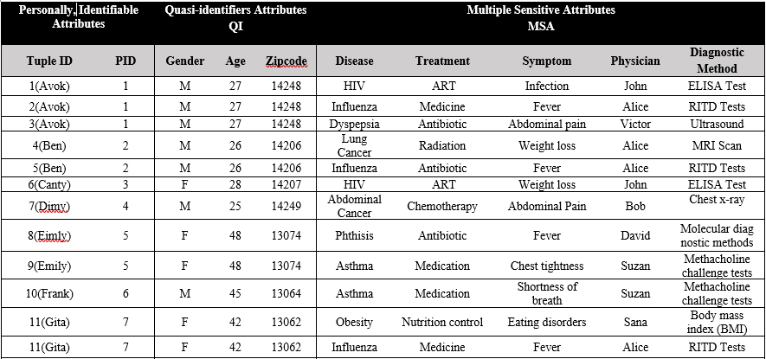
Privacy

Slide 19
Case Study Examples
Case studied related to basic security properties like confidentiality, Integrity, Availability.etc.are discussed in class.
Students are asked to evaluate complex security scenarios for security and privacy attack/data breach.
Sample case studies are shared with students for practice as home assignments.

Slide 20
References
Principles of Information Security, Michael E., Whitman & Mattord, H. J., Cengage Learning, 2017.
Computer Security: Principles and Practice, 3rd edition by William Stallings
https://www.wikipedia.org/
https://www.geeksforgeeks.org/infrastructure-security-at-network-level-in-cloud-computing/?ref=gcse
J. Heurix, P. Zimmermann, T. Neubauer, and S. Fenz, “A taxonomy for privacy enhancing technologies,” Computers & Security, vol. 53, pp. 1–17, 2015.

